Slide 1



Chapter 13
Quasi-
Experimental
and
Single-Case
Designs
@ 2012 Wadsworth, Cengage Learning

Slide 2
Topics
Conducting Quasi-Experimental Research
Types of Quasi-Experimental Designs
Internal Validity and Confounds in Quasi-Experimental Designs
Statistical Analysis of Quasi-Experimental Designs

Slide 3
Topics (cont’d.)
Developmental Designs
Conducting Single-Case Research
Types of Single-Case Designs

Slide 4
Conducting Quasi-Experimental Research

Slide 5
Conducting Quasi-Experimental Research
How does a quasi-experimental design differ from an experimental design?
  Lack of any control group or comparison group
  The independent variable is not a true manipulated independent variable
  Participants are not randomly assigned to conditions

Slide 6
Conducting Quasi-Experimental Research (cont’d.)
Nonmanipulated independent variable
  The independent variable in a quasi-experimental design in which:
    Subjects are not randomly assigned to conditions
    Instead, they come to the study as members of each condition
Example of quasi-experimental design
  John Snow’s hypothesis: people contracted cholera by drinking contaminated water

Slide 7
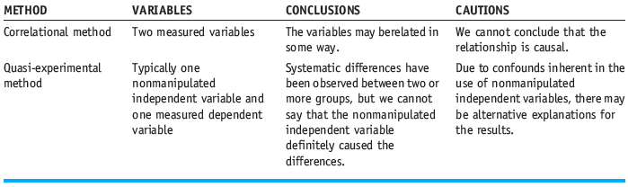
Conducting Quasi-Experimental Research (cont’d.)
Quasi-Experimental Versus Correlational Methods

Slide 8
Types of Quasi-Experimental Designs

Slide 9
Types of Quasi-Experimental Designs
Single-group posttest-only design
  A design in which a single group of participants is given a treatment and then tested
Single-group pretest/post-test design
  A design in which a single group of subjects takes a pretest, receives some treatment, and then takes a posttest measure

Slide 10
Types of Quasi-Experimental Designs (cont’d.)
Single-group time-series design: a design in which a single group of subjects is measured repeatedly before and after a treatment
Nonequivalent control group posttest-only design
  A design in which at least two nonequivalent groups are given a treatment and then a posttest measure

Slide 11
Types of Quasi-Experimental Designs (cont’d.)
Nonequivalent control group pretest/posttest design
  A design in which at least two nonequivalent groups are given a pretest, then a treatment, and then a posttest measure
Multiple-group time-series design
  A design in which a series of measures are taken on two or more groups both before and after a treatment

Slide 12
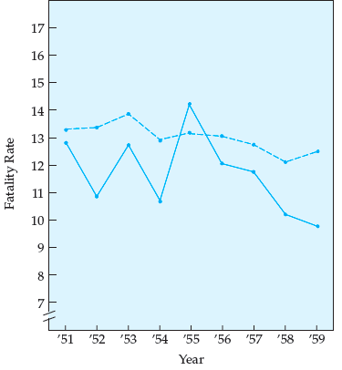
Figure 13.2
Multiple-group time-series design comparing Connecticut fatality rates (solid line) with the fatality rates of four other states (dashed line) used as a control group
SOURCE: Campbell, D. T. (1969). Reforms as experiments. American Psychologist, 24, 409-429. Copyright © 1969 by the American Psychological Association. Reprinted with permission.

Slide 13
Internal Validity and Confounds in Quasi-Experimental Designs

Slide 14
Internal Validity and Confounds in Quasi-Experimental Designs
Never conclude:
  That the independent variable definitely caused any of the observed changes in the dependent variable
Quasi-experimental designs lack internal validity

Slide 15
Statistical Analysis of
Quasi-Experimental Designs

Slide 16
Statistical Analysis of
Quasi-Experimental Designs
Data collected from a quasi-experimental design
  Analyzed in the same way as data collected through true experimental designs
Conclusions must be tempered
  Because of the confounds inherent in quasi-experimental designs

Slide 17
Developmental Designs

Slide 18
Developmental Designs
Cross-sectional design: a type of developmental design in which subjects of different ages are studied at the same time
Cohort: a group of individuals born at about the same time
Cohort effect
  A generational effect in a study that occurs when the era in which individuals are born affects how they respond in the study

Slide 19
Developmental Designs (cont’d.)
Longitudinal design: a type of developmental design in which the same subjects are studied repeatedly over time as they age
Sequential design: a developmental design that is a combination of the cross-sectional and longitudinal designs

Slide 20
Conducting Single-Case Research

Slide 21
Conducting Single-Case Research
Single-case design: a design in which only one participant is used
Small-n design: a design in which only a few subjects are studied

Slide 22
Types of Single-Case Designs

Slide 23
Types of Single-Case Designs
Reversal design
  A single-case design in which the independent variable is introduced and removed one or more times

Slide 24
Types of Single-Case Designs (cont’d.)
ABA reversal design
  A single-case design in which:
    Baseline measures are taken
    The independent variable is introduced and behavior is measured
    The independent variable is then removed and baseline measures are taken again
ABAB reversal design: a design in which baseline and independent variable conditions are reversed twice

Slide 25
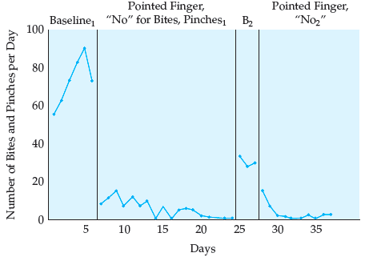
Figure 13.3 Number of bites and pinches during the school day
SOURCE: From “The Effective Use of Punishment to Modify Behavior in the Classroom” by R. V. Hall, S. Axelrod, M. Foundopoulos, J. Shellman, R. A. Campbell, & S. S. Cranston, 1971, in K. D. O’Leary (Eds.), Classroom Management: The Successful Use of Behavior Modification, p. 175. Copyright © 1972 by Allyn & Bacon. Reprinted with permission of Pearson Education.

Slide 26
Types of Single-Case Designs (cont’d.)
Multiple-baseline design
  A single-case or small-n design in which the effect of introducing the independent variable is assessed over multiple subjects, behaviors, or situations
Multiple-baseline design across subjects
  A small-n design in which measures are taken at baseline and after the introduction of the independent variable at different times across multiple subjects

Slide 27
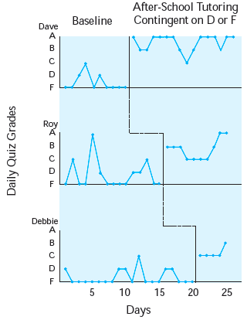
Figure 13.4
Quiz grades for three high school French students
SOURCE: From “The Effective Use of Punishment to Modify Behavior in the Classroom” by R. V. Hall, S. Axelrod, M. Foundopoulos, J. Shellman, R. A. Campbell, & S. S. Cranston, 1971, in K. D. O’Leary (Eds.), Classroom Management: The Successful Use of Behavior Modification, p. 177. Copyright © 1972 by Allyn & Bacon. Reprinted with permission of Pearson Education.

Slide 28
Types of Single-Case Designs (cont’d.)
Multiple-baseline design across behaviors
  A single-case design in which measures are taken at baseline and after the introduction of the independent variable at different times across multiple behaviors
Multiple-baseline design across situations
  A single-case design in which measures are taken at baseline and after the introduction of the independent variable at different times across multiple situations

Slide 29
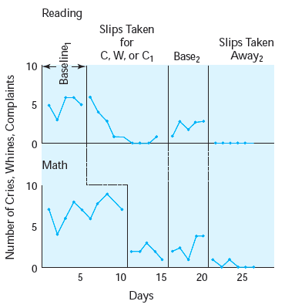
Figure 13.5
Frequency of cries (C), whines (W), and complaints (C1) during reading and math classes
SOURCE: From “The Effective Use of Punishment to Modify Behavior in the Classroom” by R. V. Hall, S. Axelrod, M. Foundopoulos, J. Shellman, R. A. Campbell, & S. S. Cranston, 1971, in K. D. O’Leary (Eds.), Classroom Management: The Successful Use of Behavior Modification, p. 180. Copyright © 1972 by Allyn & Bacon. Reprinted with permission of Pearson Education.

Slide 30
Summary
Quasi-experimental designs: a type of design that falls somewhere between a correlational design and a true experimental design
Quasi-experimental designs include single-group designs, nonequivalent control group designs, and developmental designs
Single-case or small-n designs include reversal designs and multiple-baseline designs

